Slide 1
A practical guide to supporting your own and others’ mental health
> > >

Slide 2
> > > ABOUT THIS PRACTICAL GUIDE > > >
This practical guide is designed to give you ways you can help someone, be that a colleague, friend or family member, if you feel they are experiencing mental health problems.
> > > Building Mental Health

Slide 3
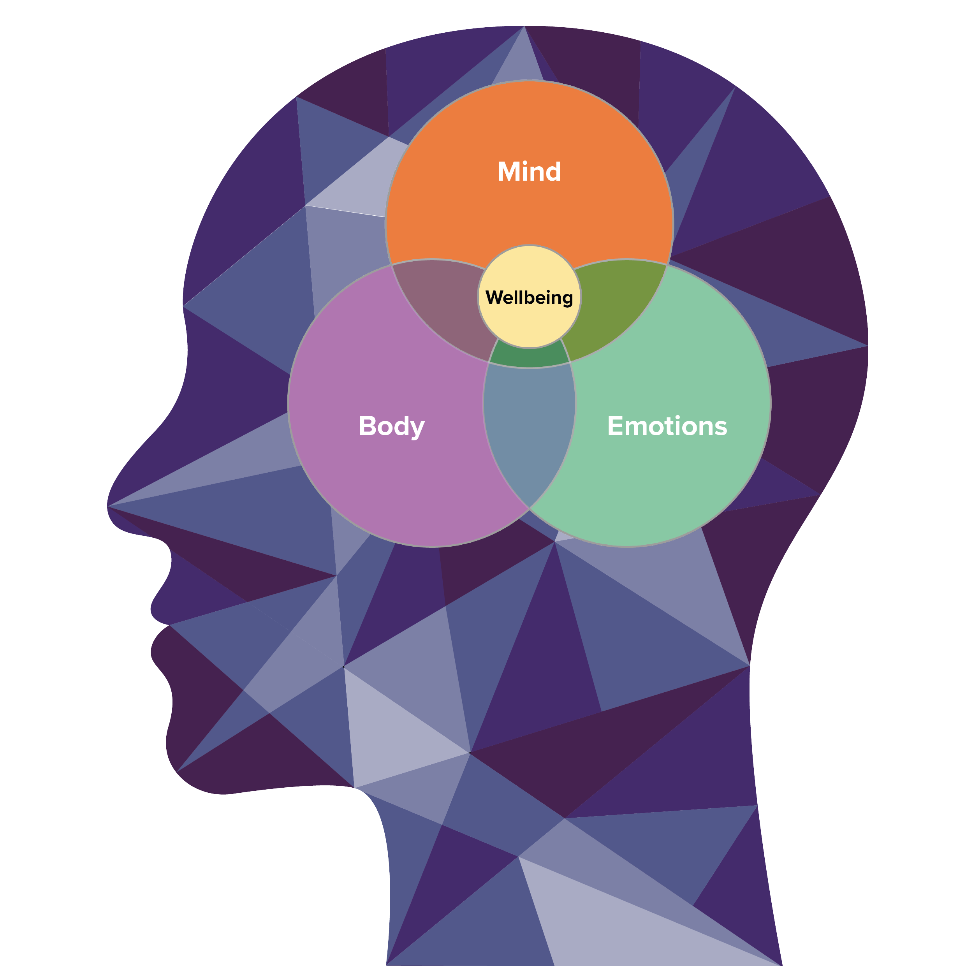
What is mental health?
The definition of ‘mental health’ covers a wide variety of topics however it is important to remember that we all have mental health.
Our mental health is fluid and can be affected by a range of factors both in a positive and negative way.
Think about stress for example, we all know what it feels like to be stressed but when that stress becomes too much it may lead to mental health problems.
> > > Building Mental Health

Slide 4
How can I support people who have poor mental health?
> > > It’s OK not to be OK…
Trying to tell the difference between what expected behaviours are and what might be the signs of a mental ill health is not always easy.
There are no easy tests that can let someone know if there are mental health problems.
However, common signs may include the following:
Lethargy
Out of character
Closed off
Personal appearance
Self-care
Motivation
Mood
Talking to someone can potentially be daunting but it is vital that you do if you think someone is experiencing mental health problems.
> > > Building Mental Health

Slide 5
7 Tips for having a conversation
MHFA England recommend the following tips to start a conversation however don’t get bogged down with these…
The most important thing is to have the conversation - this could make the difference.
> > > Building Mental Health

Slide 6
1. Choose a setting
Think about where the person will feel most comfortable and give yourself time as you don’t want to look rushed or be interrupted.
> > > MHFA Tips

Slide 7
2. Think about the language you use
Don’t offer insensitive advice such as ‘cheer up’ and try to keep the chat as positive and supportive as possible.
> > > MHFA Tips

Slide 8
3. Keep questions open ended
Ask empathetic questions such as “How are you feeling at the moment?” and give them time to answer.
The aim is not to bombard them with too many questions but for them to know you are listening.
> > > MHFA Tips

Slide 9
4. Listen and don’t judge
Respect the persons feelings and experiences even though they may be different to yours.
Listen to the words they use, tone of voice and body language, as this will help you understand how they’re feeling.
> > > MHFA Tips

Slide 10
5. Keep the conversation going
Reassure them that your door is always open and follow up to ask them how they’re doing.
Reassure them that there are many sources of support available and encourage them to seek professional help from their GP or local support service.
> > > MHFA Tips

Slide 11
6. Supporting someone in a crisis
If someone tells you they are feeling suicidal or if you suspect they are thinking of taking their own life, it is critical to encourage them to get help.
Stay calm and stay with them and if you are really concerned, call 999 for advice.
> > > MHFA Tips

Slide 12
7. Look after yourself
Supporting someone who is experiencing mental ill health can be challenging and draining and so it’s important to look after your own mental health afterwards.
> > > MHFA Tips

Slide 13
Wellbeing strategies for self and others
Action for Happiness developed the following 10 evidence-based Keys to Happier Living
If you are supporting someone or you are struggling yourself, try to incorporate these strategies into your daily life.
> > > Building Mental Health

Slide 14
1
10 KEYS…
1. GIVING
Do things for others - it makes us happier and healthier.
> > > Building Mental Health

Slide 15
1
10 KEYS…
2. RELATING
Connect with people as those who have strong broad social relationships are happier, healthier, and live longer.
> > > Building Mental Health

Slide 16
1
10 KEYS…
3. EXERCISING
Take care of your body as being active makes us happier as well as being good for our physical health.
> > > Building Mental Health

Slide 17
1
10 KEYS…
4. AWARENESS
Be in the moment and pay attention to your emotions as it helps stop us dwelling on the past or worrying about the future.
> > > Building Mental Health

Slide 18
1
10 KEYS…
5. TRYING OUT
Learning new things gives us a sense of accomplishment and boosts self- confidence and resilience.
> > > Building Mental Health

Slide 19
1
10 KEYS…
6. DIRECTION
Having ambitious but realistic goals gives our lives direction and brings a sense of accomplishment when we achieve them.
> > > Building Mental Health

Slide 20
1
10 KEYS…
7. RESILIENCE
Find ways to bounce back from stress and adversity, we cannot always choose what happens, but we can choose our own response to what happens.
> > > Building Mental Health

Slide 21
1
10 KEYS…
8. EMOTIONS
Positive emotions are great at the time, but if we experience them regularly, they create an upward spiral of positive feelings and energy.
Conversely, negative emotions can quickly lead us into a negative spiral.
> > > Building Mental Health

Slide 22
1
10 KEYS…
9. ACCEPTANCE
Learning to accept ourselves increases our enjoyment of life, our resilience, and our well-being.
> > > Building Mental Health

Slide 23
1
10 KEYS…
10. MEANING
Be part of something bigger as people who have meaning and purpose in their lives are happier, feel more in control and get more out of what they do.
> > > Building Mental Health

Slide 24
Specialist mental health services
Your NFDC is here to help you. Should you need any further help or guidance on how to deal with Mental Health in your workplace call 01442 217144.
Construction Industry Helpline
A 24/7 helpline for all construction workers and their families in the UK. Call 0345 605 1956
Samaritans
Offers confidential emotional support 24 hours a day. Call 116 123 / www.samaritans.org
Mind
Provides information on a range of mental health areas from 9am-6pm, Monday to Friday. Call 0300 123 3393 / www.mind.org.uk
Rethink
Provides solution-based guidance. Call 0300 5000927 / www.rethink.org
Anxiety UK
A helpline staffed by volunteers from 9.30am-5.30pm, Monday to Friday. Call 08444 775 774 / www.anxietyuk.org.uk
Step Change
Help and information for people dealing with debt problems. Call 0800 138 1111 / www.stepchange.org
> > > Building Mental Health

